Slide 1
An Accuracy-Lossless Perturbation Method for Defending Privacy Attacks in Federated Learning
WWW ’22: Proceedings of the ACM Web Conference 2022 (April 2022)
张文博 2022.07.22

Slide 2
Abstract
Problem:
Perturbation-based privacy preserving methods in federal learning will reduce learning accuracy.
Contributions:
The authors propose an efficient model perturbation method for federated learning to defend against reconstruction and membership inference attacks launched by curious clients.
The method is very efficient and easy to be integrated in practice and allows the server to recover the true aggregated gradients by eliminating the added noises. Therefore, this method does not hinder learning accuracy at all.

Slide 3
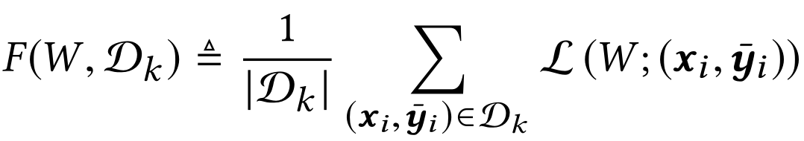

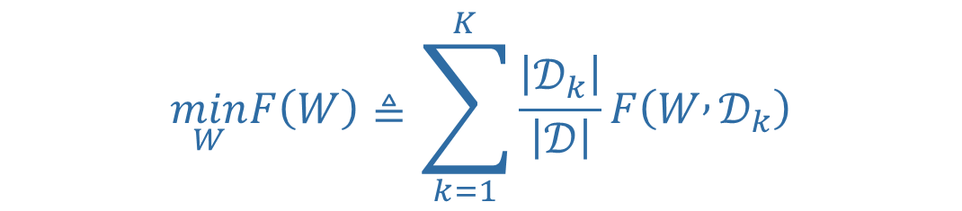
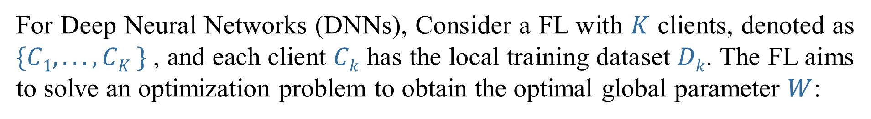

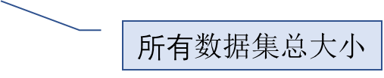


Background：Federated Learning
(Notice the mathematical notation)
For Deep Neural Networks (DNNs), Consider a FL with $K$ clients, denoted as $\{C1, . . . , CK \}$, and each client $Ck$ has the local training dataset $Dk$. The FL aims to solve an optimization problem to obtain the optimal global parameter $W$:
$Dk$数据集的大小
$$\min_{W}F\left(W\right)≜\sum_{k=1}^{K}{\frac{\left|𝒟_{k}\right|}{\left|𝒟\right|}F\left(W , 𝒟_{k}\right)}$$
$单个$客户机本地优化目标
$所有$数据集总大小
$$损失函数$$
$单条$数据

Slide 4
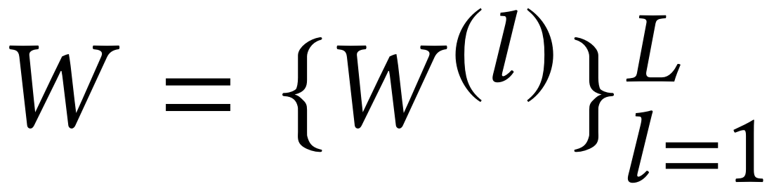
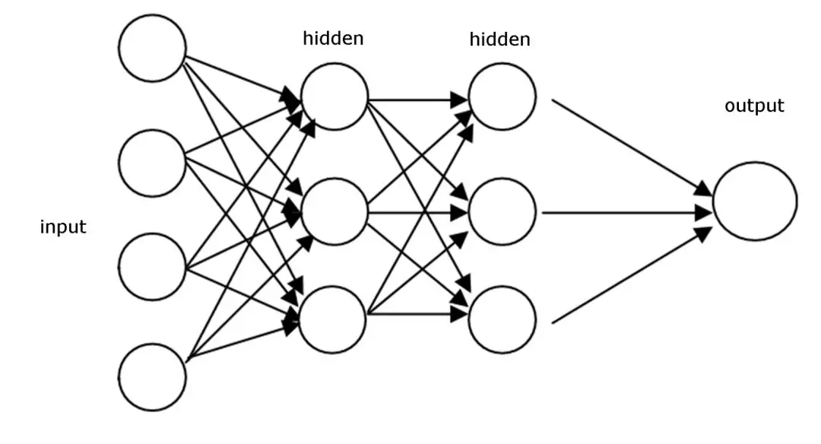
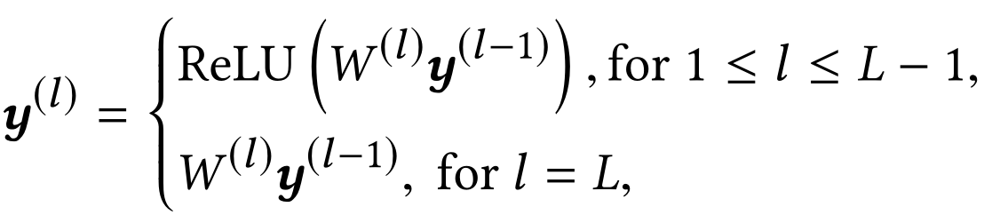
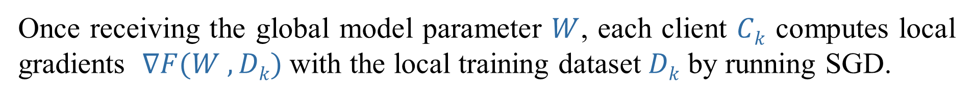
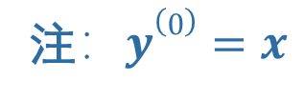
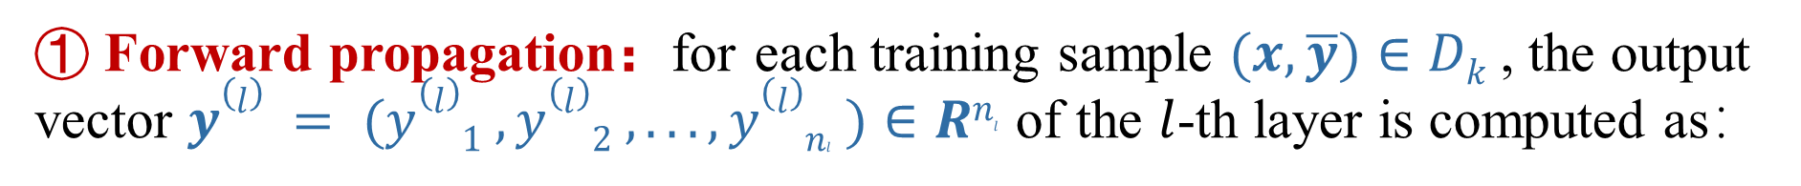
Background：Federated Learning
(1) Global model broadcasting
The server broadcasts the current model parameter
(2) Local model training
Once receiving the global model parameter $W$, each client $Ck$ computes local gradients $∇F(W , Dk)$with the local training dataset $Dk$ by running SGD.
① Forward propagation：for each training sample $(x, \overline{y})∈Dk$, the output vector $y(l) = (y(l)1 ,y(l)2 , . . . ,y(l)nl )∈Rnl$ of the $l$-th layer is computed as：
0 1 2 3
注$：y(0)=x$

Slide 5
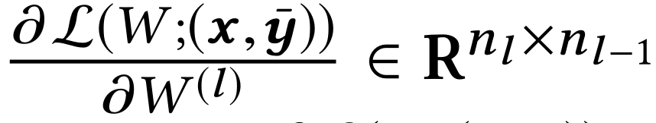
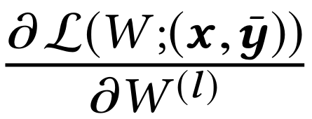
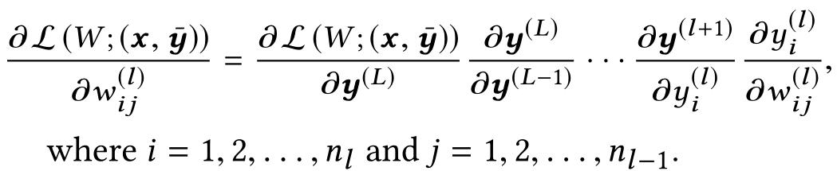
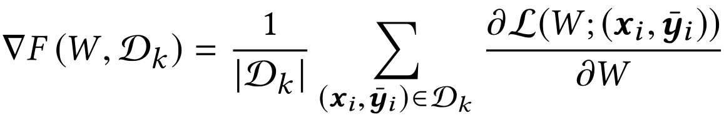
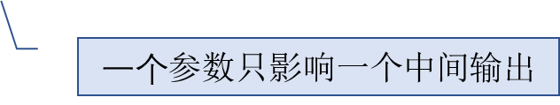
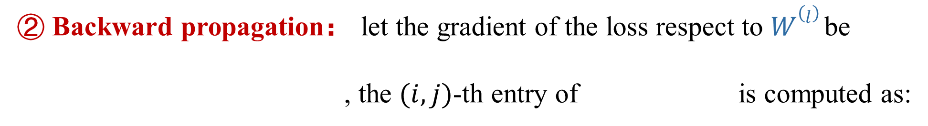
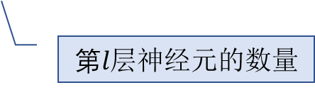
Background：Federated Learning
② Backward propagation： let the gradient of the loss respect to $W(l)$be
, the $(i, j)$-th entry of is computed as:
$第l$层神经元的数量
$一个$参数只影响一个中间输出
Finally, $Ck$ uploads $∇F(W, Dk)$ to the server for model update.

Slide 6
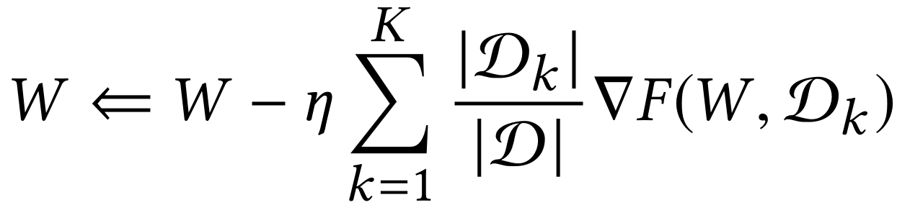
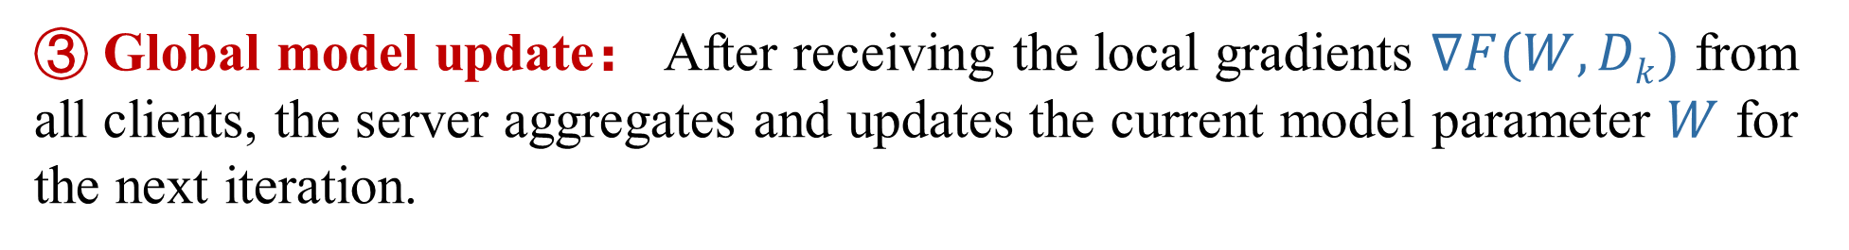
Background：Federated Learning
③ Global model update： After receiving the local gradients $∇F(W, Dk)$ from all clients, the server aggregates and updates the current model parameter $W$ for the next iteration.
学习率
After that, the server distributes the updated parameter $W$ to all clients for the next iteration.

Slide 7

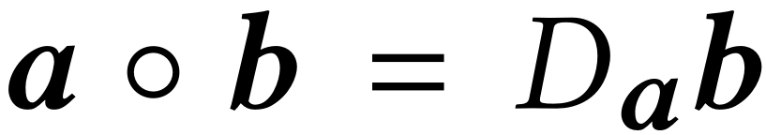
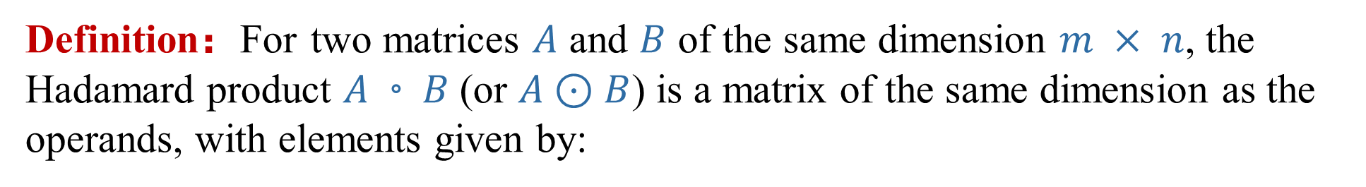
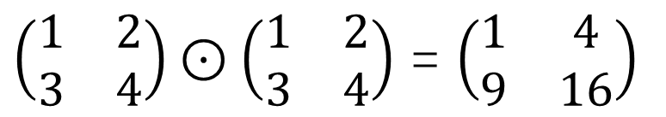
Background：Hadamard Product (Element-wise)
Definition：For two matrices $A$ and $B$ of the same dimension $m × n$, the Hadamard product $A◦B$(or $A⊙B$) is a matrix of the same dimension as the operands, with elements given by:
$\left(\begin{matrix}1 & 2 \\ 3 & 4\end{matrix}\right)⊙\left(\begin{matrix}1 & 2 \\ 3 & 4\end{matrix}\right)$ = $\left(\begin{matrix}1 & 4 \\ 9 & 16\end{matrix}\right)$
For example:
Properties:
对角矩阵
列向量a和b
以a的元素为主对角线元素的对角矩阵

Slide 8
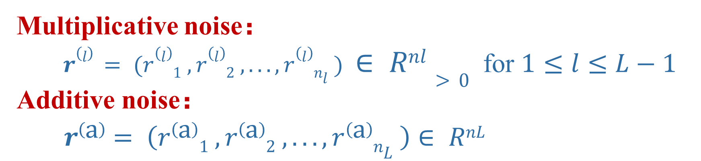
The Authors’ Method：Global Model Perturbation
Multiplicative noise：
$r(l) = (r(l)1 , r(l)2 , . . . , r(l)nl ) ∈ Rnl>0$ for $1≤l≤L−1$
Additive noise：
$$r\left(a\right)= \left(r\left(a\right)1 , r\left(a\right)2 , . . . , r\left(a\right)nL \right)∈ RnL$$

Slide 9
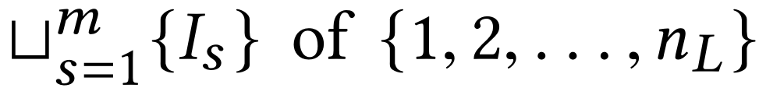
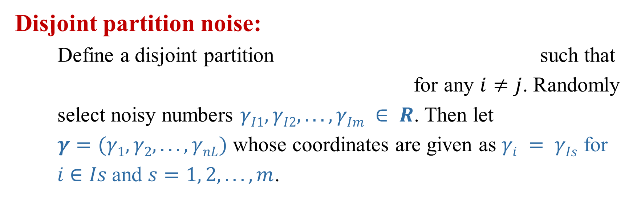
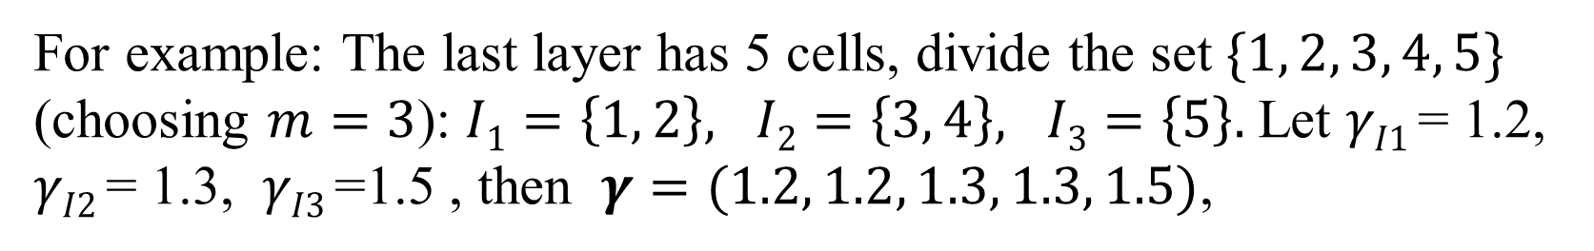
The Authors’ Method：Global Model Perturbation
Disjoint partition noise:
Define a disjoint partition such that
for any $i≠j$. Randomly
select noisy numbers $γI1,γI2, . . . ,γIm ∈ R$. Then let
$γ=(γ1,γ2, . . . ,γnL)$ whose coordinates are given as $γi = γIs$ for
$i∈Is$and $s=1, 2, . . . ,m$.
m自选且与隐私保护程度有关
最后一层神经元数
For example: The last layer has 5 cells, divide the set $\{1, 2, 3, 4, 5\}$
(choosing $m=3$): $I1=\left\{1, 2\right\}, I2=\left\{3, 4\right\}, I3=\left\{5\right\}.$Let $γI1$= 1.2, $γI2$= 1.3, $γI3$=1.5 , then $γ=(1.2, 1.2, 1.3, 1.3, 1.5)$,

Slide 10
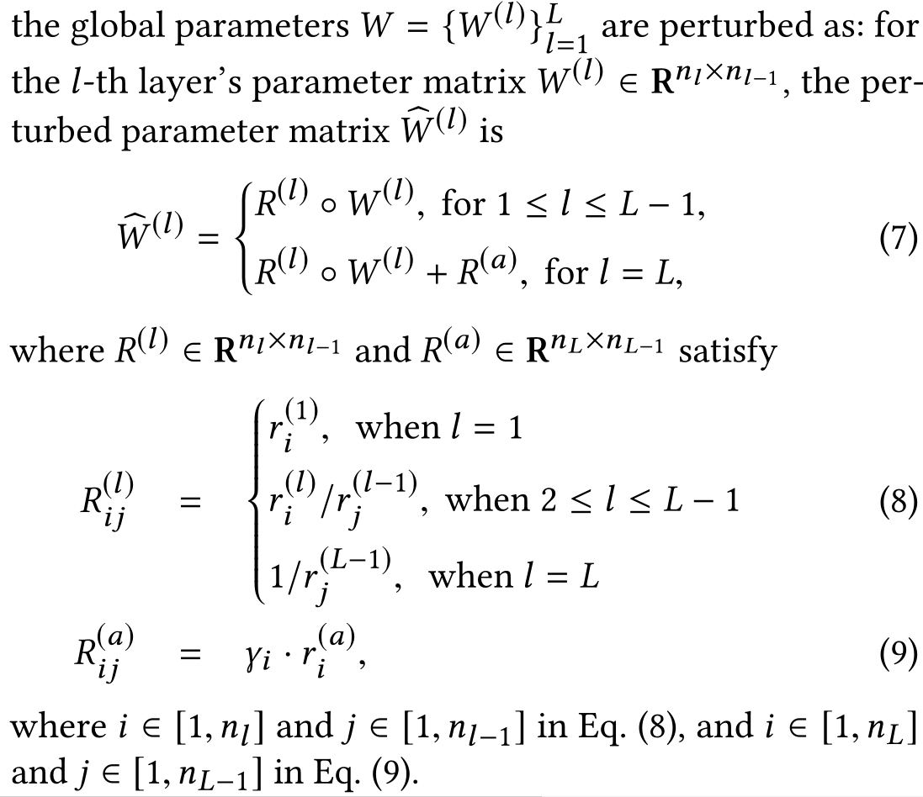
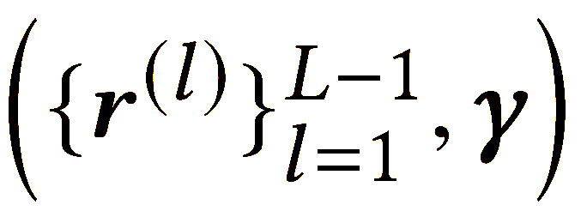
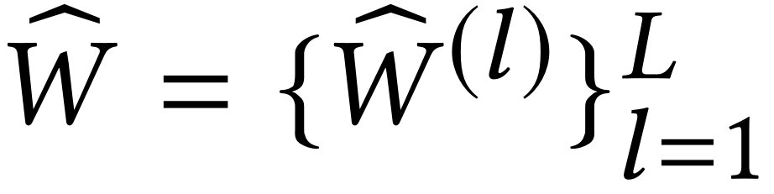
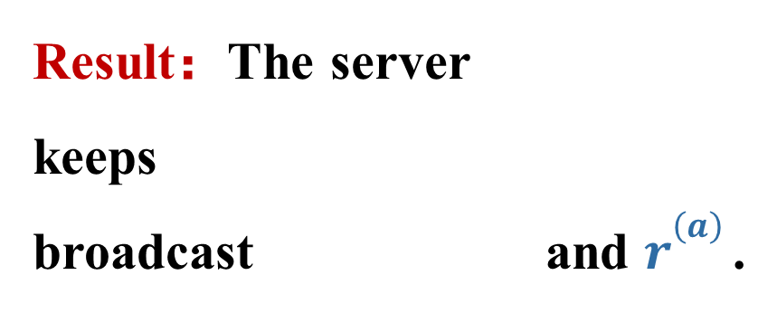
The Authors’ Method：Global Model Perturbation
Parameter perturbation:
由乘法噪声计算，作用于所有网络层
由加法噪声和划分噪声计算，仅作用于最后一层
每行元素相同
Result：The server
keeps
broadcast and $r(a)$ .
每列元素相同
每行元素相同

Slide 11
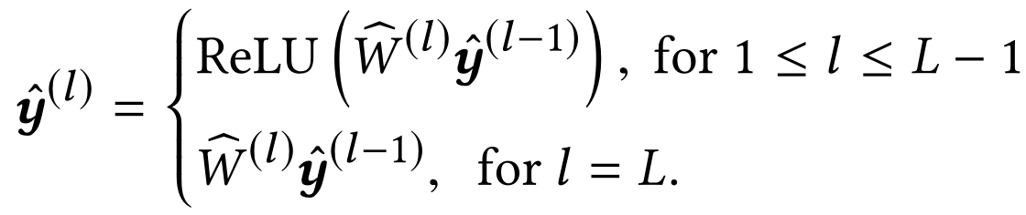
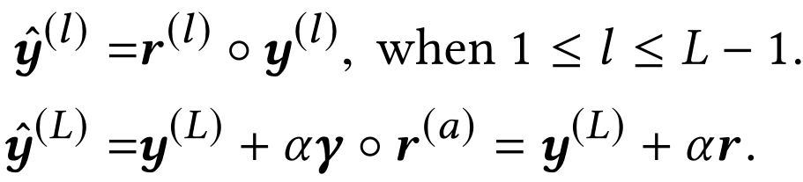
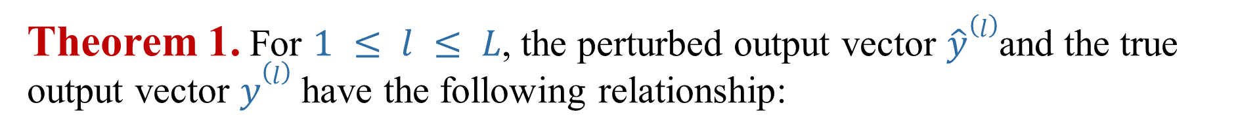
The Authors’ Method：Local Model Training
Forward Propagation:
(Same as normal federated learning, but $y,W$ is perturbed)
Theorem 1. For $1 ≤ l ≤ L$, the perturbed output vector $\hat{y}(l)$and the true output vector $y(l)$ have the following relationship:

Slide 12
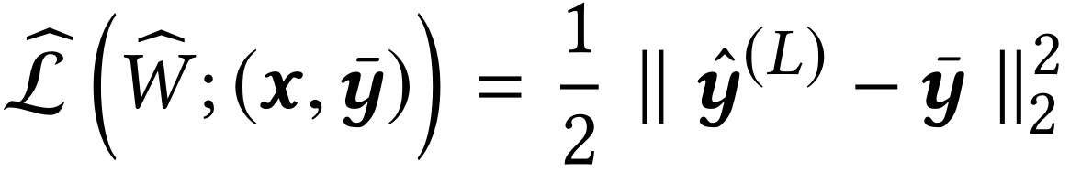
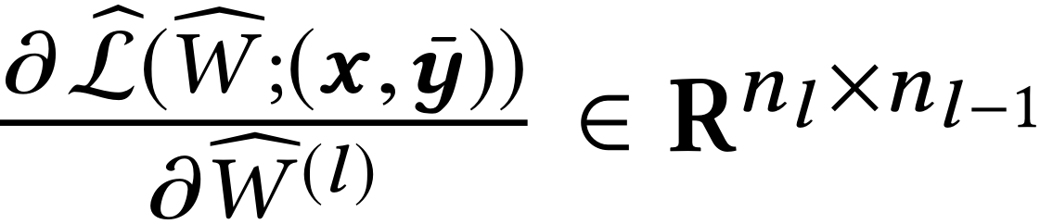
The Authors’ Method：Local Model Training
Backward Propagation:
$Ck$ can compute the perturbed gradient of the $l$-th layer

Slide 13
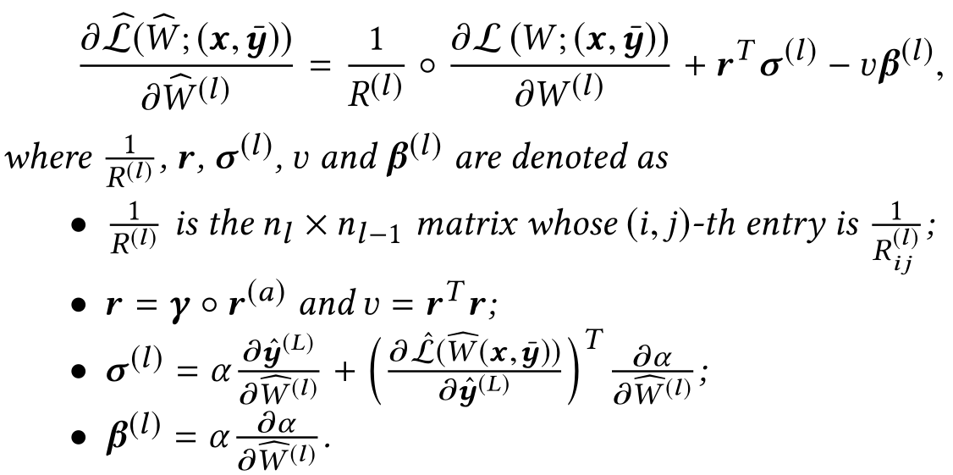
The Authors’ Method：Local Model Training
Theorem 2. For $1 ≤ l ≤ L$, the perturbed gradients and true gradients satisfy
can be computed directly by clients
(defined in theorem 1)

Slide 14
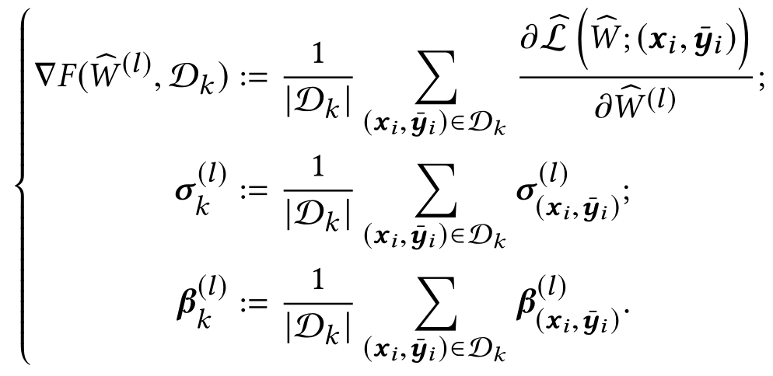

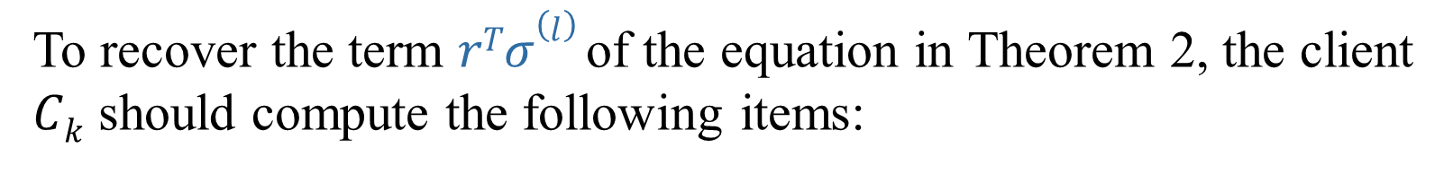
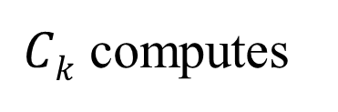
The Authors’ Method：Local Model Training
Hence, for $l = 1, 2, . . . , L :$
$Ck$ computes
To recover the term $rTσ(l)$of the equation in Theorem 2, the client
$Ck$ should compute the following items:

Slide 15
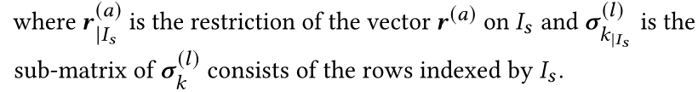
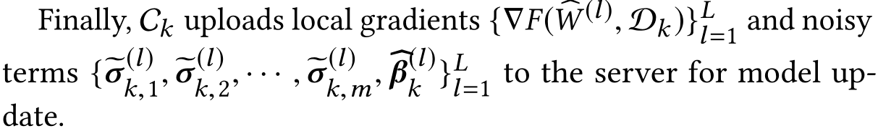
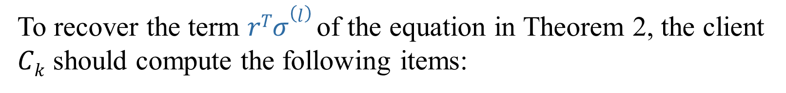
The Authors’ Method：Local Model Training
To recover the term $rTσ(l)$of the equation in Theorem 2, the client
$Ck$ should compute the following items:

Slide 16
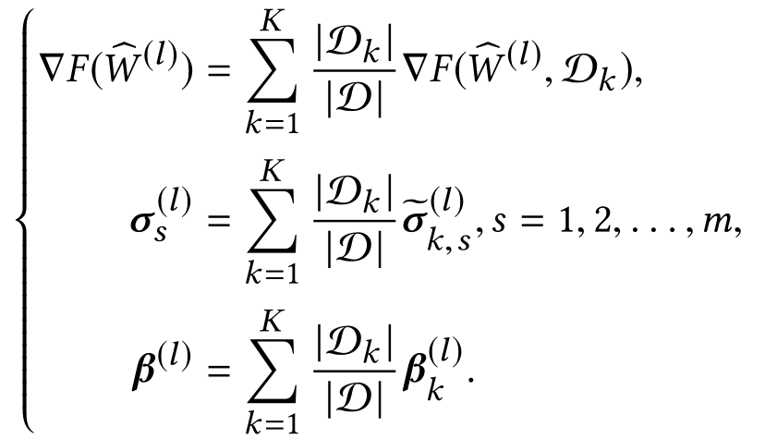
The Authors’ Method：Global Model Update
For $l = 1, 2, . . . , L$, perform the aggregation operation as:

Slide 17
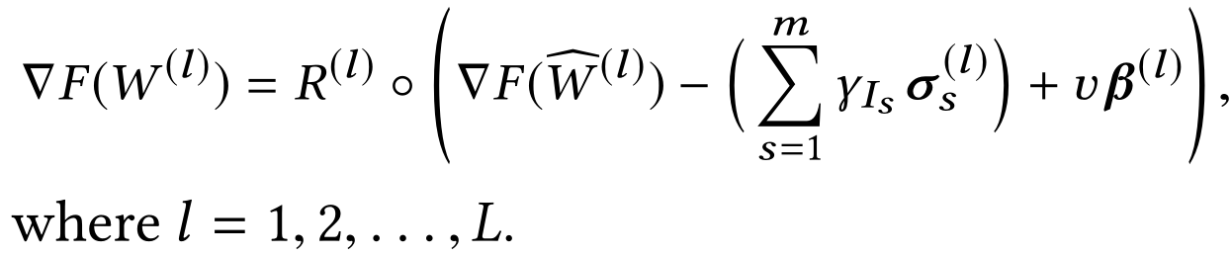
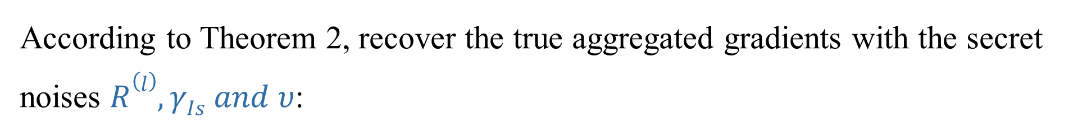
The Authors’ Method：Global Model Update
According to Theorem 2, recover the true aggregated gradients with the secret noises $R(l), γIs and υ$:
本式为Theorem 2 移项所得
Update the current global model for the next iteration as:

Slide 18
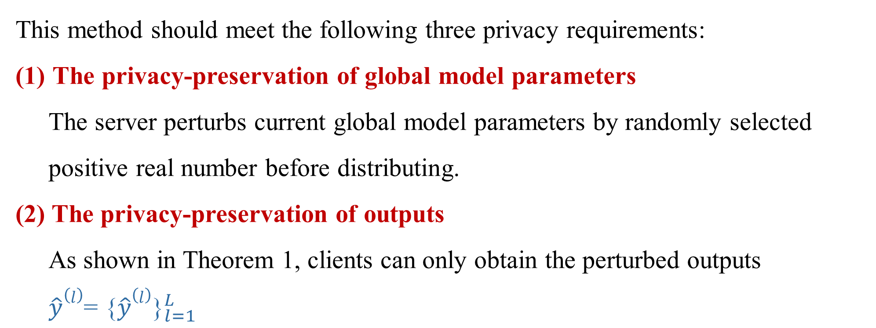
Theoretical Analysis
This method should meet the following three privacy requirements:
The privacy-preservation of global model parameters
The server perturbs current global model parameters by randomly selected positive real number before distributing.
(2) The privacy-preservation of outputs
As shown in Theorem 1, clients can only obtain the perturbed outputs $\hat{y}(l{)\text{=} \text{\{}\hat{y}(l)\text{\}}}_{l=1}^{L}$

Slide 19
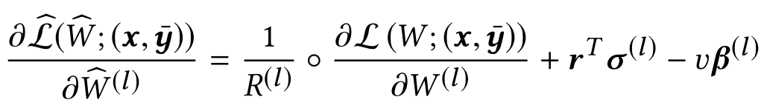
Theoretical Analysis
(3) Privacy-preservation of gradients
server
client

Slide 20
Performance Evaluation（Overview）
Baseline：FedAvg，PPDL，SPN，DBCL
Datasets：UMBD，LDC，CIFAR 10， Meituan Co-Branded Credit Cards
Experiments：
Learning Accuracy: Regression，Classification
Scalability Evaluation：5 or 50 clients on industrial dataset
Experiments against Privacy Attacks：Membership Inference Attacks，Reconstruction Attacks

Slide 21
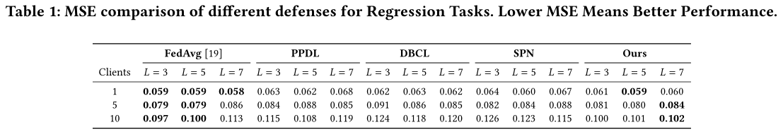
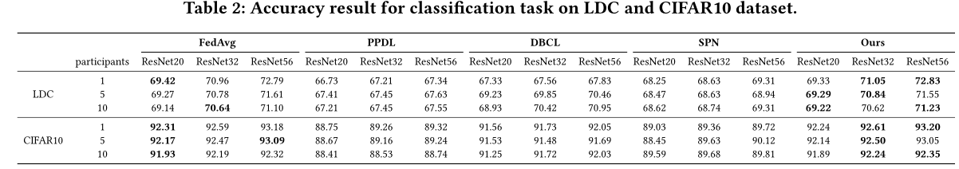
Performance Evaluation
Learning Accuracy: Regression，Classification

Slide 22
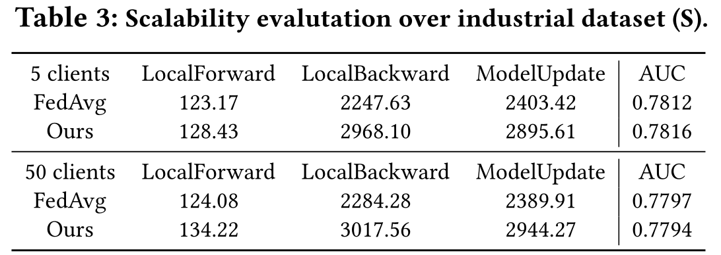
Performance Evaluation
(2) Scalability Evaluation

Slide 23

Performance Evaluation
(3) Experiments against Privacy Attacks (Membership Inference Attacks)

Slide 24



Performance Evaluation
(3) Experiments against Privacy Attacks (Reconstruction Attacks)
注：Disk越大说明重构效果越差，ASR越小说明重构效果越差。

Slide 25
Thank You For Listening！
张文博 2022.07.22

